Slide 1
Solar Power

Slide 2
Battery capacity & characterizing
The ability of a battery to supply with constant energy a given load for a given amount of time
Amp Hours (Ah)
1Ah = 1A for 1 hour
Ignores voltage change
Assumes constant current load
Watt Hours (Wh)
1Wh = 1W for 1 hour
True capacity
Takes voltage into account

Slide 3

Discharging curve of an ideal battery
U, V
1.5
0
t, s

Slide 4
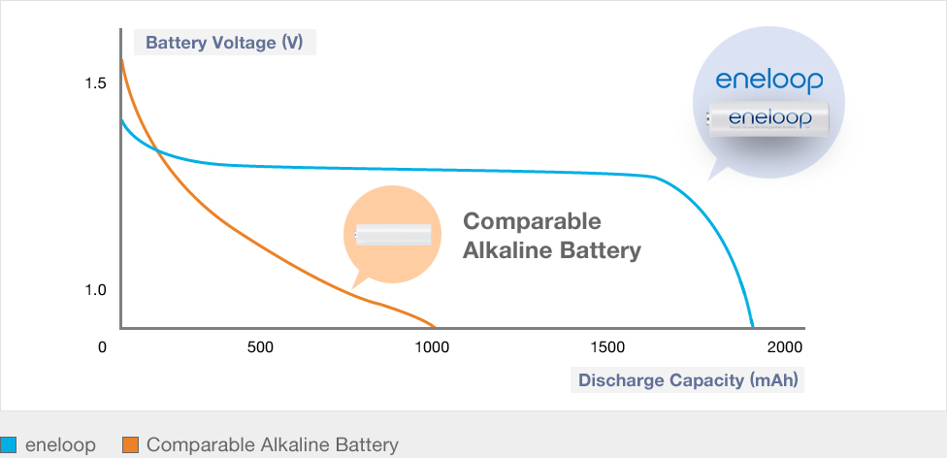
Discharging curve
Brick wall response

Slide 5
Is there really a huge difference between Ah & Wh?
Well, in the common case – not really.

Slide 6
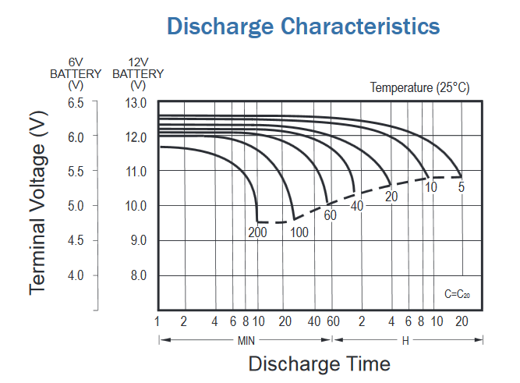
Discharging curve for the specific battery

Slide 7
Demo

